Slide 1

CNSCC.203 Computer Networks Application Layer
Muhammad Azhar Iqbal
azhar.iqbal@lancaster.ac.uk
Credit goes to Dr. Matt Broadbent, Dr. Vasileios Giotsas, and Dr. Wenjuan Yu at SCC for designing module SCC.203.

Slide 2
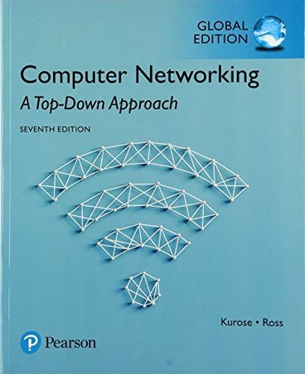

Application layer: overview
Principles of network applications
Socket programming with UDP and TCP
Application architectures
Web and HTTP
E-mail, SMTP, IMAP
The Domain Name System DNS
Chapter 2.1, 2.2, 2.5, 2.7

Slide 3
Week 1: Recap
Computer Network (CN) Definition
CN Distinction and Advantages
Building Blocks of CN
Hardware
Core, Edge, Link (Medium)
Software
Network Architecture and Protocols
Types of CNs
Directly Connected
Point-to-Point
Multiple Access
Indirectly Connected (Switched)
Circuit-Switched
Packet Switched
Packet-Switched (Store-and-Forward)
Transmission Rate
Transmission Delay
Internet
Nuts and Bolts View
Service View
Internet Structure
Other Concepts
Protocols
(Protocols define the format, order of messages sent and received among network entities, and actions taken on msg transmission, receipt )
Access Network
(Network that physically connects an end system to the first (edge) router on a path from the end system to any other distant end system.)

Slide 4
Week 2: Recap
Performance Metrics
Delay (Latency)
Throughput
Loss
Types of Delay
Processing delay
Queuing delay
Transmission delay
Propagation delay
Commands
Ping
Tracert
Internet (TCP/IP) Protocol Stack
Application Layer (Layer 5)
Transport Layer (Layer 4)
Network Layer (Layer 3)
Link Layer (Layer 2)
Physical Layer (Layer 1)

Slide 5
Some network apps
social networking
Web
text messaging
e-mail
multi-user network games
streaming stored video (YouTube, Hulu, Netflix)
P2P file sharing
voice over IP (e.g., Skype)
real-time video conferencing
Internet search
remote login
…
Q: your favorites?

Slide 6








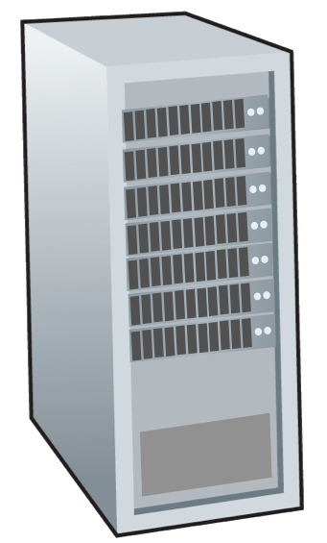







Creating a network app
write programs that:
run on (different) end systems
communicate over network
e.g., web server software communicates with browser software
no need to write software for network-core devices
network-core devices do not run user applications
applications on end systems allows for rapid app development, propagation
application
transport
network
data link
physical
mobile network
national or global ISP
local or regional ISP
home network
content
provider
network
application
transport
network
data link
physical
application
transport
network
data link
physical
datacenter
network
enterprise
network

Slide 7
Processes communicating
process: program running within a host
within same host, two processes communicate using inter-process communication (defined by OS)
processes in different hosts communicate by exchanging messages
clients, servers
client process: process that initiates communication
server process: process that waits to be contacted
note: applications with P2P architectures have client processes & server processes
Notes:
A process sends messages into, and receives messages from, the network through a software interface called a socket.
Client and Server Processes
With P2P file sharing, the peer that is downloading the file is labeled as the client, and the peer that is uploading the file is labeled as the server.

Slide 8

Sockets
process sends/receives messages to/from its socket
socket analogous to door
sending process shoves message outdoor
sending process relies on transport infrastructure on other side of door to deliver message to socket at receiving process
two sockets involved: one on each side
Socket is the interface between the application layer and the transport layer within a host, which is also referred to as the Application Programming Interface (API)
application
socket
application
controlled by
app developer
process
process
transport
transport
network
network
controlled
by OS
link
Internet
link
physical
physical
Notes:
The Interface Between the Process and the Computer Network
A process sends messages into, and receives messages from, the network through a software interface called a socket. A process is analogous to a house and its socket is analogous to its door. When a process wants to send a message to another process on another host, it shoves the message out its door (socket).

Slide 9
Identifying Network Processes
A process on host is addressed using two identifiers:
IP address
Network layer identifier
32 bits (IPv4) or 128 bits (IPv6)
Port number
transport layer identifier (16 bits)
example port numbers: HTTP server: 80, mail server: 25
"5 tuple" uniquely identifies traffic between hosts:
Two IP addresses, two port numbers, underlying transport protocol (e.g., TCP or UDP)
Example: 206.62.226.35,p21+ 198.69.10.2,p1500, TCP
Example: 206.62.226.35,p21+ 198.69.10.2,p1499, UDP

Slide 10
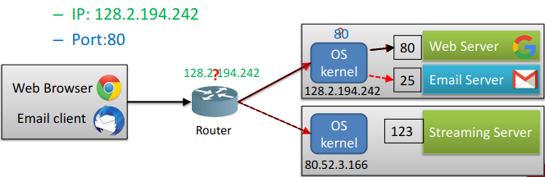
Why do we need both IP addresses and port numbers?
Many processes can be running on the same host
IP is used by routers to forward messages to the correct host
The OS kernel uses the port number to forward messages to the correct process
Example: request for the web server

Slide 11
Knowing What Port Number To Use
Popular applications have well-known ports
E.g., port 80 for Web and port 25 for e-mail
See http://www.iana.org/assignments/port-numbers
Well-known vs. ephemeral ports
Server has a well-known port (e.g., port 80)
Between 0 and 1023 (requires root to use)
Client picks an unused ephemeral (i.e., temporary) port
Between 1024 and 65535

Slide 12
Knowing What Port Number To Use
Between the protocols User Datagram Protocol (UDP) and Transmission Control Protocol (TCP), there are 65,535 ports available for communication between devices. Among this impressive number are three classes of ports:
Well-known ports: Range from 0–1,023
Registered ports: Range from 1,024–49,151
Dynamic/Private ports: Range from 49,152–65,535

Slide 13
An application-layer protocol defines:
types of messages exchanged,
e.g., request, response
message syntax:
what fields in messages & how fields are delineated
message semantics
meaning of information in fields
rules for when and how processes send & respond to messages
open protocols:
defined in RFCs, everyone has access to protocol definition
allows for interoperability
e.g., HTTP, SMTP
proprietary protocols:
Tied to specific products
e.g., Skype

Slide 14
What transport service does an app need?
data integrity
some apps (e.g., file transfer, web transactions) require 100% reliable data transfer
other apps (e.g., audio) can tolerate some loss
throughput
some apps (e.g., multimedia) have throughput requirements, e.g., a minimum amount of throughput to be “effective”
other apps (“elastic apps”) make use of whatever throughput they get
timing
some apps (e.g., Internet telephony, interactive games) require low delay to be “effective”
security
encryption, data integrity, …

Slide 15
Transport service requirements: common apps
application
file transfer/download
e-mail
Web documents
real-time audio/video
streaming audio/video
interactive games
text messaging
data loss
no loss
no loss
no loss
loss-tolerant
loss-tolerant
loss-tolerant
no loss
throughput
elastic
elastic
elastic
audio: 5Kbps-1Mbps
video:10Kbps-5Mbps
same as above
Kbps+
elastic
time sensitive?
no
no
no
yes, 10’s msec
yes, few secs
yes, 10’s msec
yes and no

Slide 16
Internet transport protocols services
TCP service:
reliable transport between sending and receiving process
flow control: sender won’t overwhelm receiver
congestion control: throttle sender when network overloaded
connection-oriented: setup required between client and server processes through handshaking procedure
does not provide: timing, minimum throughput guarantee, security
UDP service:
unreliable data transfer between sending and receiving process
does not provide: reliability, flow control, congestion control, timing, throughput guarantee, security, or connection setup.
Notes:
TCP Services
The TCP service model includes a connection-oriented service and a reliable data transfer service.
Connection-oriented service. TCP has the client and server exchange transport-layer control information with each other before the application-level messages begin to flow. This so-called handshaking procedure alerts the client and server, allowing them to prepare for an onslaught of packets. After the handshaking phase, a TCP connection is said to exist between the sockets of the two processes.
Reliable data transfer service. The communicating processes can rely on TCP to deliver all data sent without error and in the proper order. When one side of the application passes a stream of bytes into a socket, it can count on TCP to deliver the same stream of bytes to the receiving socket, with no missing or duplicate bytes.
UDP Services
UDP is a no-frills, lightweight transport protocol, providing minimal services. UDP is connectionless, so there is no handshaking before the two processes start to communicate. UDP provides an unreliable data transfer service—that is, when a process sends a message into a UDP socket, UDP provides no guarantee that the message will ever reach the receiving process. Furthermore, messages that do arrive at the receiving process may arrive out of order.

Slide 17
Internet transport protocols services
application
layer protocol
FTP [RFC 959]
SMTP [RFC 5321]
HTTP 1.1 [RFC 7320]
SIP [RFC 3261], RTP [RFC 3550], or proprietary (e.g., Skype) HTTP [RFC 7320], DASH
WOW, FPS (proprietary)
application
file transfer/download
e-mail
Web documents
Internet telephony
streaming audio/video
interactive games
transport protocol
TCP
TCP
TCP
TCP or UDP
TCP
UDP or TCP

